Slide 1
Tips on how to find your niche for your products
http://blog.etrend.sk/tomas-tiefenbach/9-tipov-ako-objavit-vlastny-niche-a-zarobit.html

Slide 2
Adapt
inspire from competitors or even companies from other sectors
some of their tricks will definitely be able to adapt to your business
For example:
Nike Shox sneakers were inspired by dampers in F1 car

Slide 3
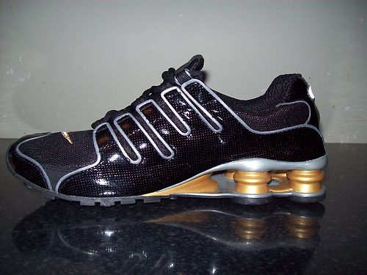

Slide 4
Add a little extra
What about adding something extra for the costumer?
Ideally something that does not cost a lot, but the customer gets the impression that for their money they got more than from competitors.

Slide 5
Add a little extra
For example:
McDonalds created Happy Meal a product - food, in combination with a toy. The original product - hamburger with Coke - was offered by hundreds of other competitors.
McDonalds added a toy to the original product and took a very attractive niche - children. In this niche could then McDonalds continue to build and offer other associated products - such celebrations for children.

Slide 6
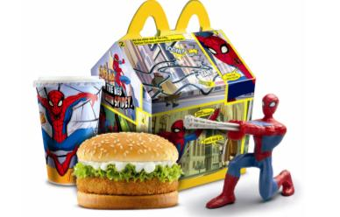

Slide 7
Be intuitive
If your product can be used by a child without training, you are well on your way

Slide 8
Be intuitive
For example:
Apple iPhone product put stakes at the simplicity and intuitiveness - unpack it from the box and you can almost instantly start using it without studying the manual. Its products will appeal to both niche design enthusiasts but also technical untalented, which had previously preferred keyboard phones.

Slide 10
Personalize
It's a great way to create your own market segment.
For example
Jibbitz has based its business on producing children fun decorations for Crocs sandals. During the four years Jibbitz was bought by Crocs for $ 10 million!

Slide 11
